Slide 1
Sitecore Discover SITECORE USER GROUP PPT Oct 10, 2021

Slide 2


Sitecore Discover in a nutshell
Artificial Intelligence
Visitor
Customer

Slide 3
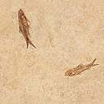

Sitecore Discover Features
Individualized Search
Product Recommendations
Analytics
A/B testing for merchandising
Multi-locale Support
Category optimization
Intent identification
Merchandising resources
SEO Support

Slide 4
References
https://reflektion.com/
https://www.sitecore.com/products/discover

